Slide 1
Azure Virtual Machines

Slide 2
IaaS Cloud Services
On-demand, scalable computing resource
Need more control over computing environment
IaaS is an instant computing infrastructure, provisioned and managed over internet

Slide 3
Business Scenarios
Test and development
Website hosting
Storage, backup and recovery
Web Apps
High-performance computing
Big data analysis
Extended Datacenter

Slide 4
Planning Checklist
Start with Network
Name the VM
Decide the location of the VM
Determine the size of the VM
Pricing
Storage
OS

Slide 5
Name the VM
Element | Example
Environment | Dev, prod, QA
Location | uw, ue
Instance | 01, 02, 03, 04, 05, 06, 07, 08, 09
Product or service | service
Role | Sql, web, messaging
Ex: Devusc-webvm01 – First development web server hosted in US South Central Location

Slide 6
Location
The location can limit your available options
There are price differences between locations

Slide 7
Pricing
Compute – Compute expenses are priced on a per-hour basis but billed on a per-minute basis.
Consumption-based – Pay-As-You-Go
Reserved Virtual machine
Storage – You are charged separately for the storage that VM uses.

Slide 8
Virtual Machine Sizing
General Purpose
Compute Optimized
Memory Optimized
Storage Optimized
GPU
High Performance Compute
Note: Be cautious when resizing production VMs

Slide 9
Virtual Machine Disks
OS Disk – OS disk has OS pre-installed
Temporary Disk – Non-persistent storage
Data Disk

Slide 10
Supported Operating System
Windows
Linux

Slide 11
Connect to VM
Windows RDP – 3389
Linux SSH – 22

Slide 12
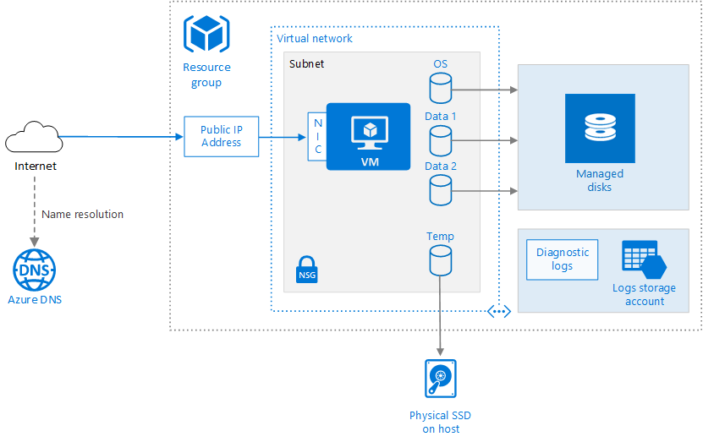

Slide 13



Stop VM
Shutdown
Close the RDP
Portal
CLI
20.25.106.203
20.232.186.56

Slide 14
Virtual Machine Availability

Slide 15
Maintenance and Downtime
Unplanned Hardware Maintenance – Live Migration
Unexpected Downtime - Heals
Planned Maintenance

Slide 16
Availability Options
Availability Set – Prevent from Rack level failure
Availability Zone – Prevent from Datacenter level failure
Virtual Machine Scale Sets – Auto Scale

Slide 17
SLA
Single VM with Premium Disk – 99.90%
Availability Set – 99.95%
Availability Zone – 99.99%

Slide 18
Availability Set
It is a logical feature used to ensure that a group of related VMs are deployed so that they are not all subjected to single point of failure.

Slide 19
